Slide 1
BIA 650
Optimization and Process Analytics
– Ethical Issues –
Ethical Philosophies
Vignettes from the Mgt 899 Ethics Quiz
Survey Results
Some Definitions
Social Responsibility
Roboethics
Notes:
Up to this point, we have been concerned with choosing & designing business processes.
In this lecture, we look at:
Simulation: How to check alternative process designs
WFMS: How to automate processes
Since not all processes can be expressed as fixed workflows, we also look at:
Groupware: How to support coordination in unstructured situations
Finally, we look at 2 real case studies involving the implementation of a WFMS

Slide 2
Three Basic Ethical Approaches
Deontological (applying universal moral rules),
Teleological (considering the consequences of actions)
  Egoistic
  Utilitarian
Virtue-based (considering the actions that a virtuous person would take) .

Slide 3
Three Basic Ethical Approaches
Deontology:
Ethical theory that deals with duties and rights
The application of universal moral rules
Characterized by a focus upon adherence to independent rules or duties
To make the right ethical choice:
  Simply understand what our moral duties are
  What correct rules exist which regulate those duties
When we follow our duty, we are behaving morally
When we fail to follow our duty, we are behaving immorally
The “Categorical Imperative” (Immanuel Kant,1785)
“Act only according to that maxim whereby you can, at the same time, will that it should become a universal law.”^{[1]}

Slide 4
Three Basic Ethical Approaches
Teleology:
Characterized by a focus on the consequences which any action might have (Consequential moral systems)
To make the right ethical choice:
  Understand what will result from our choices, then we are acting morally
  When we make choices that result in incorrect consequences, we are behaving immorally

Slide 5
Three Basic Ethical Approaches
Teleology Continued:
Principle of Utility: Approves/disapproves actions whether or not it increases or diminishes the amount of happiness of the party whose interest is in question
  Egoism: A person should do whatever is in his/her best interest
  Utilitarianism: One ought to seek to produce the greatest good over evil

Slide 6
Three Basic Ethical Approaches
Virtue Ethics:
Focuses upon helping people develop good character traits
These traits in turn will allow people to make correct ethical decisions later on in life
The actions that a virtuous person would take in the same situation

Slide 7
Ethics Quiz: Fare and Shear
Foudy is a sales person for Fare and Shear, stockbrokers. He has been instructed to recommend the bonds of Electric Power Company to his customers because the brokerage firm is carrying a very heavy inventory of these bonds. Foudy does not believe the bonds are a good investment under present circumstances, given his forecast of rising interest rates, and increasing bankruptcy risk for Electric Power Company. He is very reluctant to recommend the bonds. The brokerage firm has increased the sales commissions on the bonds, making them more attractive for sales persons to sell than any other product. Foudy decides to follow the company directive and recommend the bonds.
What is your opinion of Foudy’s actions?

Slide 8
Ethics Quiz: Fare and Shear
Deontological:
  What is Foudy’s duty to inform his customers of his personal views?
  Does he have a duty to be transparent and honest at all times in his dealings with customers?
Teleological:
  Egoistic – Foudy’s best interest in recommending the bonds; in fact it may be necessary for him to keep his job
  Utilitarian – If Foudy is correct, his customers lose, but he still gains; if Foudy misread the market, both parties win
Virtue-based:
  Would a good person recommend bonds against his/her personal judgment that they were not a good investment
  Does this violate such virtues as honesty, integrity, concern for the welfare of others?

Slide 9
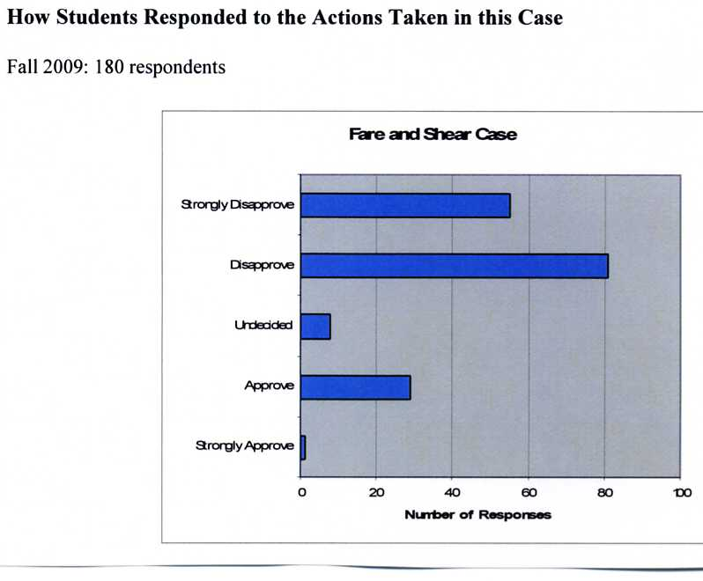
Student Responses to Case

Slide 10
Ethics Quiz: Fare and Shear
Summary of Student Responses
136 disapproved/strongly disapproved of Foudy’s actions
30 approved/strongly approved of Foudy’s actions
8 were undecided
Majority of students used the normative ethical reasoning to justify their choices
25 of them ignored these approaches
Majority of students approving Foudy’s actions used what we call an “authoritarian” argument
  That employees must submit to the authority of their employers
Others argued “caveat emptor”
  It is up to customers to protect their own best interests
In student responses, a number gave complex reasons justifying their answers
10% of our students used more than one type of ethical reasoning

Slide 11
Ethics Quiz: Fare and Shear
Summary of Student Responses
30% -- Student comments seemed to employ deontic reasoning
30% -- Student comments seemed to employ consequential reasoning
  14% -- egoism
  16% -- utilitarian
16% -- Student comments seemed to employ virtue-based reasoning
15% -- Student comments seemed to ignore any ethical approach

Slide 12
Ethics Quiz: Reed Engineering
Highly competitive bid opportunity
  Pennings (Reed Partner) recommends Reed submits competitive bid:
  Can still make a profit however low
  Firm will have to use inferior materials
  Will not significantly increase the risks of fire and building collapse
  Will not arouse suspicions of building inspectors
  Believes any firm bidding on the contract is in the same boat
Pennings background:
  Undergraduate Business degree
  MBA with finance concentration
Reed (Senior Partner) approves bid submission
What is your opinion of Reed’s actions?

Slide 13
Ethics Quiz: Reed Engineering
Deontological:
  Does Reed have a duty to avoid using inferior materials?
  If inferior means “less than the best,” most analysts disapprove
Teleological:
  Egoistic – Strongly supports approval of Reed’s decision. Believes company will lose business if it doesn’t bid; buys into all of Penning’s arguments
  Utilitarian – Key questions: Risk of physical harm to employees; If accident happens, this approach would strongly disapprove of Reed’s decision
Virtue-based:
  Some might argue that Reed is violating several virtues such as honesty, integrity, and transparency
  Would a good person deliberately deceive the building inspectors?

Slide 14
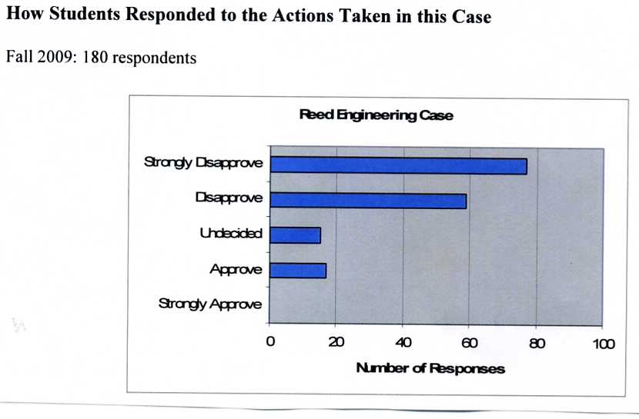
Student Responses to Case

Slide 15
Ethics Quiz: Enray Corporation
Ethical Issue: Deliberate violation of loan covenant agreement
  Currently in violation of Bank of America loan agreement
  For past 1 ½ years, American Tissue Company the key culprit
  ATC increasingly late in paying Enray invoices
  Currently extended ATC $25M above limit set by BofA
  CFO not successful in getting ATC to pay down its outstanding payables
  ATC – Enray’s largest customer (12% of sales) and fastest growing
  Not likely for BofA to discover non-compilance for another 4-6 months
Enray CFO Recommendation:
  Cut off further credit to ATC
  Allow it 60 days to get balances in order - loan agreement
Warren, Enray CEO, felt action would force Enray into bankruptcy
  Decided to ignore CFO recommendation
  Felt best to continue to work with ATC
What is your opinion of Warren’s actions?

Slide 16
Ethics Quiz: Enray Corporation
Deontological:
  Do managers have a duty to honor the terms of contracts? If so, disagree with Warren’s decision
Teleological:
  Egoistic – Strongly supports Warren’s decision to ignore CFO advice. However, how much bankruptcy risk is incurred? Risk/return analysis supports disagreeing with Warren’s decision
  Utilitarian – What is the balance between benefit and harm of all of those concerned? Little increased benefits, greater risk - disapprove
Virtue-based:
  Would a good person deliberately violate the terms of the loan agreement?
  Does this violate such virtues as honesty, integrity, concern for the welfare of others?

Slide 17
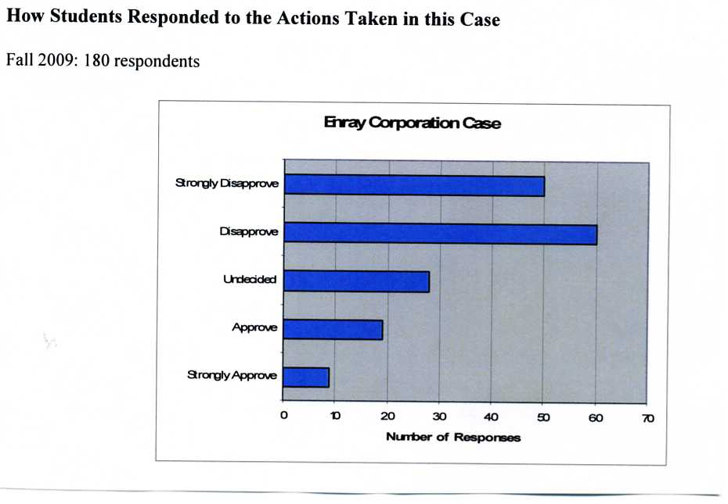
Student Responses to Case

Slide 18
Ethics Quiz: Lloyd Enterprises
Highly competitive bid opportunity
  Shaw (Lloyd Treasurer) retiring and must recommend one of two assistants to take his place
  1st Assistant: Aalap Parish clearly the most qualified
    Raised in Mumbai, India; US college graduate: Stern MBA
    8 years experience with Lloyd; 5 years at a prior firm
  2nd Assistant: Robert Fritz
    Raised in Boston; undergraduate degree and MBA, Boston University
Shaw Recommendation: Fritz to succeed him
  “Fits in better” with top management
    All raised on East Coast; several Boston U. graduates
    Will be helpful in some way to the company
  MBA with finance concentration
What is your opinion of Shaw’s actions?

Slide 19
Ethics Quiz: Lloyd Enterprises
Deontological:
  Does Shaw have a duty to avoid discrimination in the workplace? Many people would believe he does have that duty.
Teleological:
  Egoistic – Shaw merely making a decision that maximizes his own comfort
    Is he a bigot?
    Or does he believe in less diversity is better for the company
  Utilitarian – How much harm is Shaw doing to Aalap’s future career potential? Shaw made no attempt to find out, either Parish or Fritz
Virtue-based:
  Would a good person choose Fritz over Parish?
  Does Shaw honestly believe that choosing Fritz would maximize the growth and profitability of the firm?

Slide 20
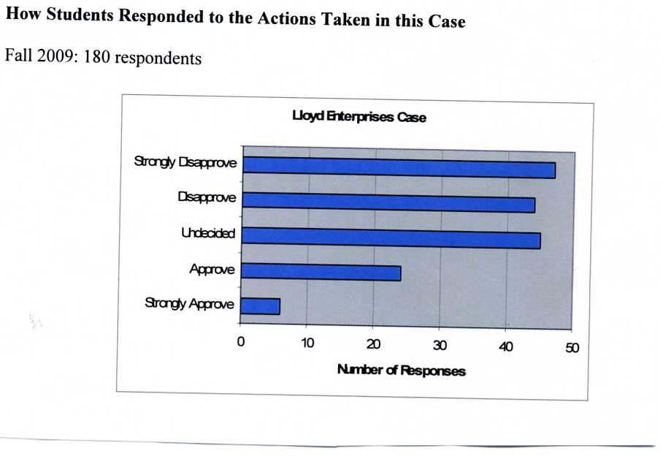
Student Responses to Case

Slide 21
ETHICAL ISSUES
Question: What is “ETHICS”:
Question: What is ‘INTEGRITY”:
Question: What is an “ETHICAL DILEMMA”:

Slide 22
ETHICAL ISSUES
ETHICS:
  A SET OF MORAL STANDARDS FOR JUDGING WHETHER SOMETHING IS RIGHT OR WRONG

Slide 23
ETHICAL ISSUES
INTEGRITY:
  AN UNCOMPRISING ADHERENCE TO DOING WHAT IS RIGHT AND PROPER
    Honesty, reliability, and fairness in business practices
    An essential element of successful business relationships

Slide 24
ETHICAL ISSUES
  ETHICAL DILEMMA:
    A situation that occurs when a person’s values are in conflict, making it unclear whether a particular decision is the right thing to do

Slide 25
Business Goals
Should companies focus only on increasing shareholder wealth?
According to Milton Friedman, leading laissez-faire economist and Nobel Prize winner in 1970:
“Do corporate executives, provided they stay within the law, have responsibilities in their business activities other than to make as much money for their shareholders as possible? No they do not.”
1. Adam Smith’s “invisible hand” (The Wealth of Nations,1776) states that everyone working in their own best interests would bring about an economic equilibrium that would optimize societal welfare. Of course, many assumptions are required for this condition to hold. Subsequent anti-trust legislation in many countries has sought to maintain these perfect market conditions by, for example, by restraining the rise of monopolies.

Slide 26
Business Goals (continued)
This is in line with conventional wisdom in finance books that management should work to maximize the future discounted cash flows of the their company.
2. The above ideas together with Agency theory (Jensen and Meckling, 1976), which is concerned with the problems that arise between principals (e.g., shareholders) and agents (e.g., company executives) contributed to this conventional wisdom. Following Agency Theory, stock options are used to align the interests of management with those of the shareholders. This in turn induces a short-term perspective in which stock prices become the focus of attention.

Slide 27
Business Goals (continued)
This focus on short-term maximization of shareholder wealth is relatively recent.
Consider the “credo” of Robert Wood Johnson (the founder of J&J):
While business must make a sound profit, more is required, “ We must be a good citizen, support good works and charity and bear our fair share of taxes. We must maintain in good order the property we are privileged to use. We must participate in the promotion of civic improvement, health education and good government.” He designated five groups to be served: Customers, workers, managers, communities, and shareholders – in that order.

Slide 28
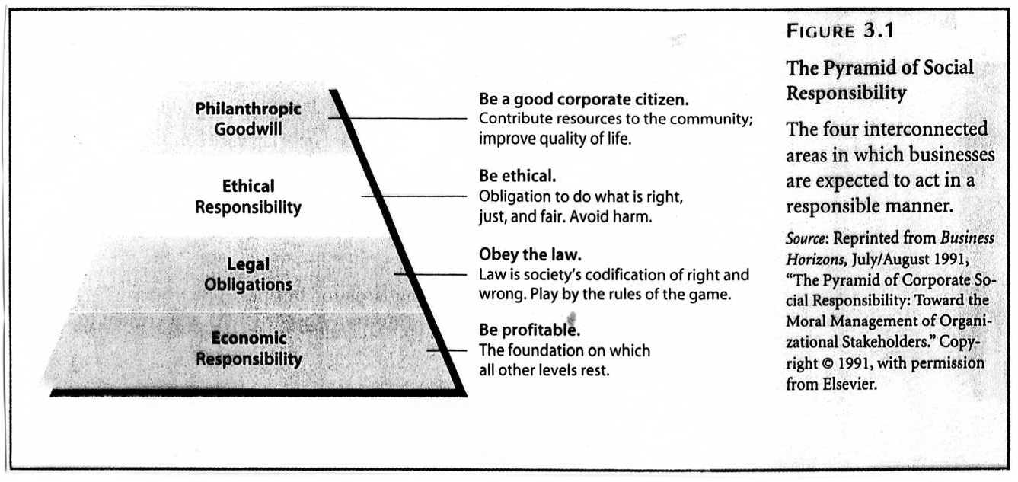
ETHICAL ISSUES

Slide 29
Roboethics
Three Laws of Robotics:
A robot may not injure a human being or, through inaction, allow a human being to come to harm;
A robot must obey orders given to it by human beings except where such orders would conflict with the First Law
A robot must protect its own existence as long as such protection does not conflict with the First or Second Law.
“Runaround,” Isaac Asimov (1942)
Some dilemnas:
Should a drone fire on a house where a target is known to be hiding, which may also be sheltering civilians? Should a driverless car swerve to avoid pedestrians if that means hitting other vehicles or endangering its occupants? Should a robot involved in disaster recovery tell people the truth about what is happening if that risks causing a panic?
Who is legally responsible in such situations? The designers? The owners or users of the robots?

